Slide 1
HealthSecret (Daily Diet & Fitness Plan App)
Presented by : RSF2 G5 Low Hong Ming
Fung Wai Lun

Slide 2
Contents
Introduction
Problems
Solutions
Navigation Structure
Screen Design
Conclusion
Q & A session

Slide 3
Introduction
allow the user to check their daily burned calories
daily, weekly, and monthly report is generated to show the user their calories burned for every meal
there are recommended consume or burn calories for the user to reach their target
allow the user to know the calories of the type of food they insert

Slide 4
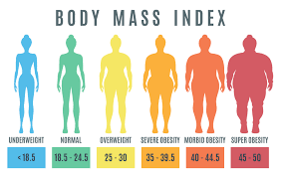
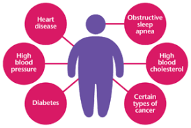
Problems
Youth have health issues that arise from :
bad habits
poor hygiene
obesity
lazy to do exercise

Slide 5
Solutions
mobile application are designed
-help them to maintain their health and weight
-decrease the obesity case
-motivate them to do more exercise

Slide 6
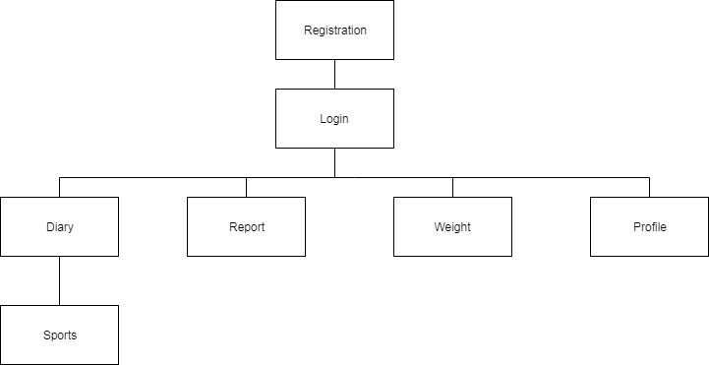
Navigation Structure

Slide 7
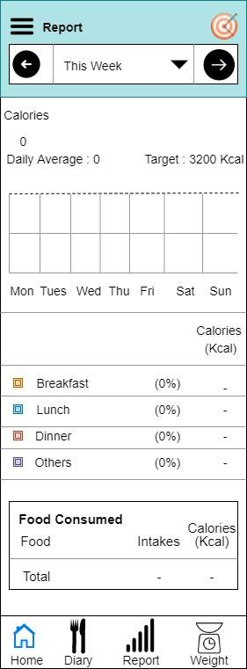
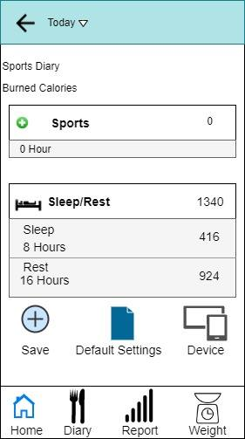
Screen Design

Slide 8
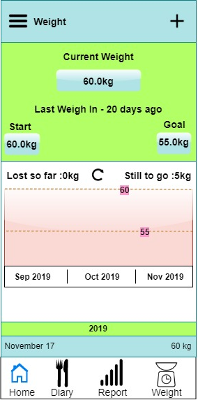
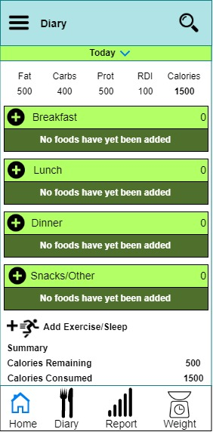
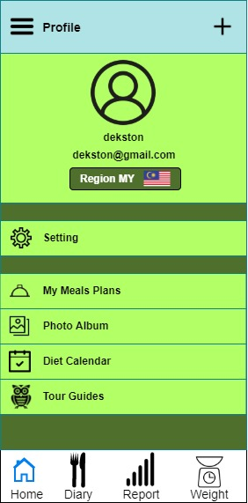
Screen Design

Slide 9

Conclusion
Hope can solve the obesity problem and youth can
maintain a healthy lifestyle

Slide 10

Q&A session

